Slide 1

Predict Customer Behavior to Term Deposit using ML Models
Longling Tian
10/06/2022

Slide 2

Agenda
Problem Statement
Data Processing
Model Deployments & EDA
Model Selection

Slide 3
Problem Statement – Bank Marketing Strategy
Problem statement: ABC Bank wants to sell it's term deposit product to customers and before launching the product they want to develop a model which help them in understanding whether a particular customer will buy their product or not (based on customer's past interaction with bank or other Financial Institution).
Why ML Model: Bank wants to use ML model to shortlist customer whose chances of buying the product is more so that their marketing channel (tele marketing, SMS/email marketing etc.) can focus only to those customers whose chances of buying the product is more.
Choice of ML model:
Linear regression
Logistic regression
Ensemble method: random forest
Boosting method: XGBoost
Stacking

Slide 4
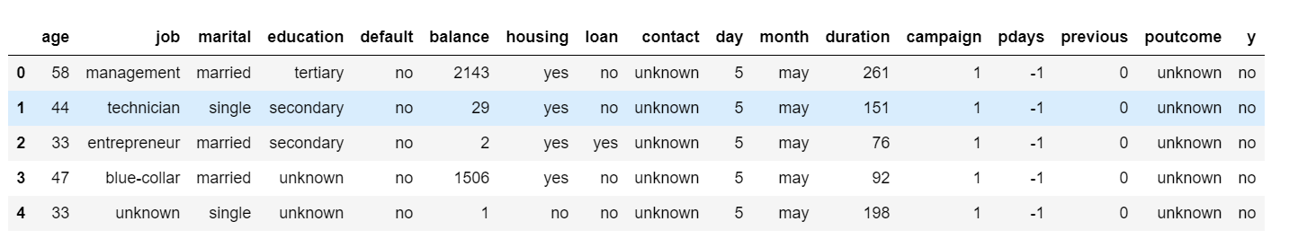
Data Understanding
Number of data points: 45,211 for bank_full.csv, 4521 for bank.csv
No N/A values
A glance of the dataset:

Slide 5
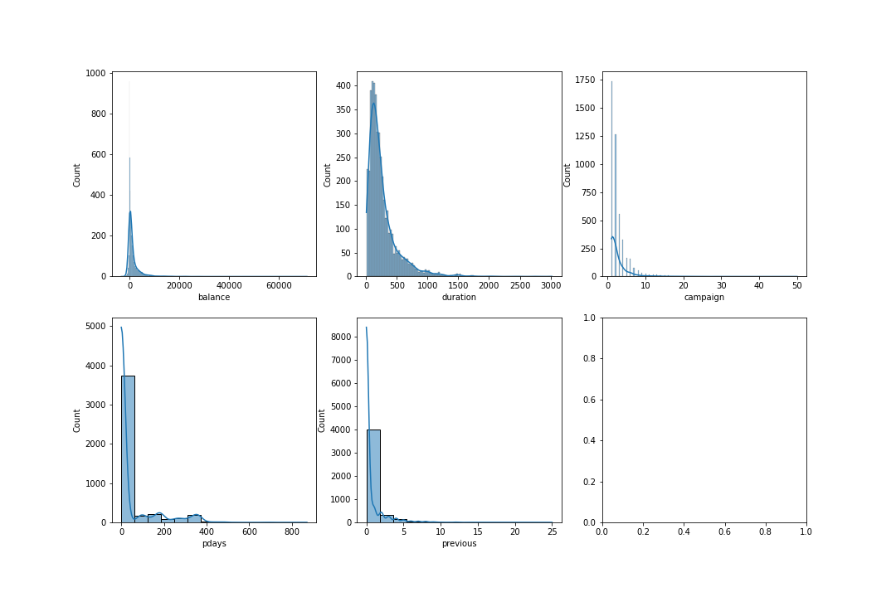
Distribution
Highly Skewed dataset (mostly positively skewed or have bulk values of zero)

Slide 6
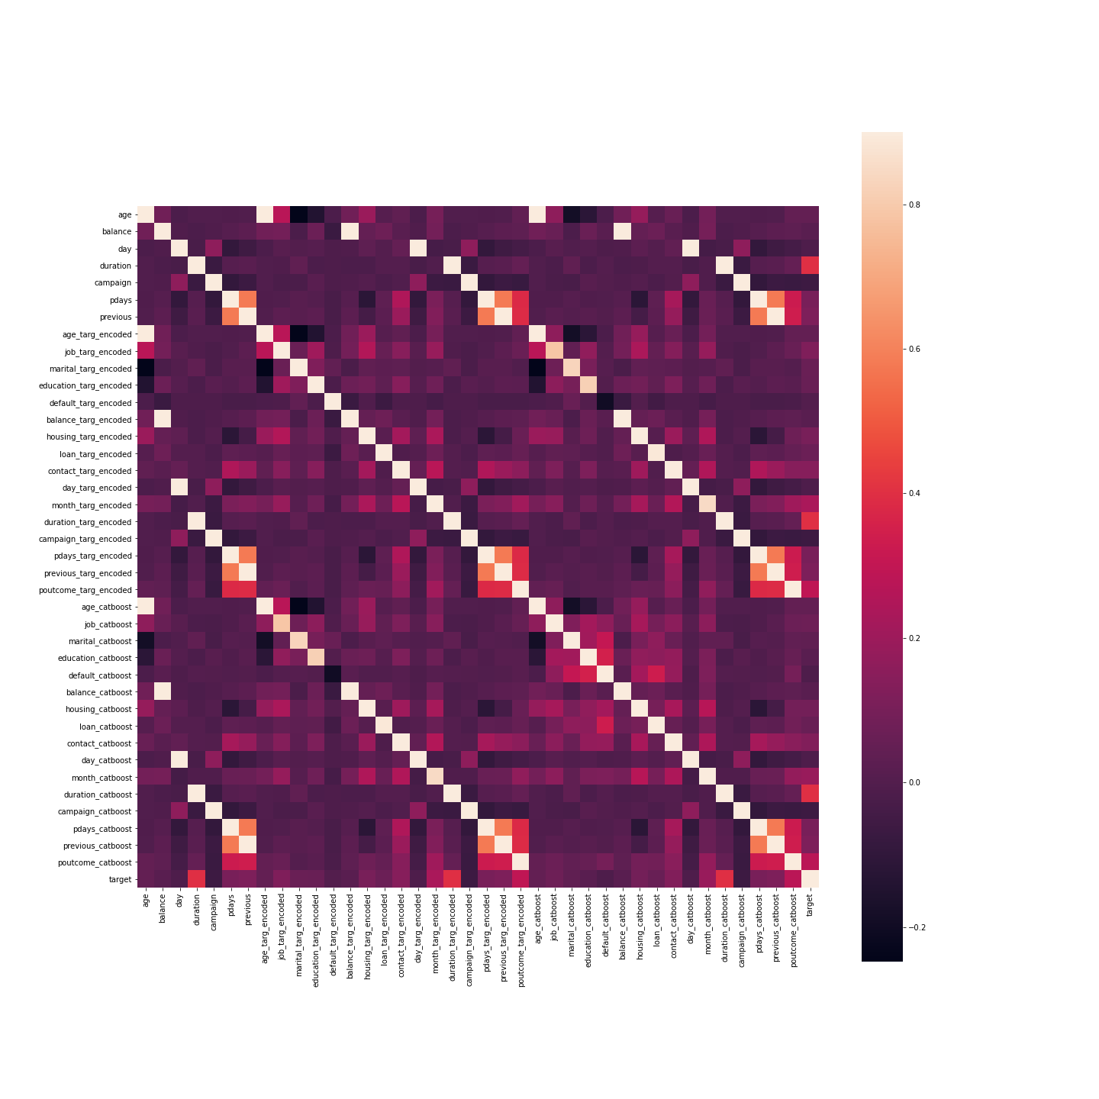
Correlation Map
According to the heatmap, no specific column is largely correlated to the target variable (last column). Also, features themselves are not highly correlated.
The tilted white lines are caused by the deployment of encoders, which will be covered later.

Slide 7
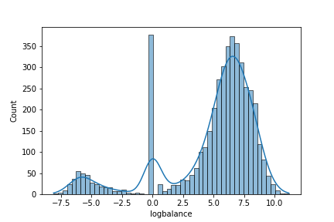
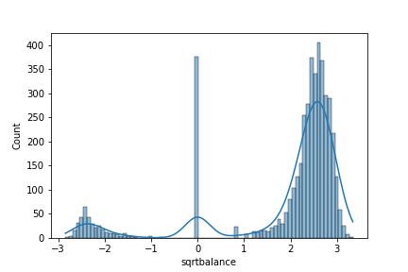
Data processing
Log Transformation
Further sqrt Transformation
Log transformation and square root transformation largely decrease the skewness.

Slide 8
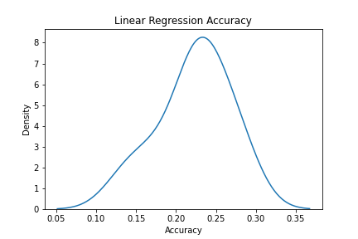
Training ML models – Linear Regression
As shown on the distributional plot, our linear regression model works very bad on both training and test sets, achieving a accuracy of only around 25%. This is consistent with what we expected as our problem is a classification problem instead of regression.

Slide 9
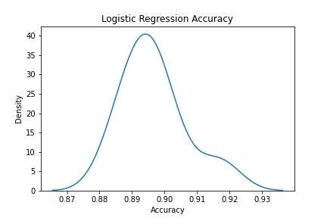
Training ML models – Logistic Regression
Logistic regression worked great on this classification problem, achieving an average accuracy of 89.6% on training data.

Slide 10
Training ML models – Encodings
For the logistic and regression models trained, one-hot encoding was applied on the string columns. However, different encoders may affect model accuracy.
For this study, three encoders, namely weight-of-evidence (WOE), target encoder, and CatBoost will be deployed on the training set.

Slide 11
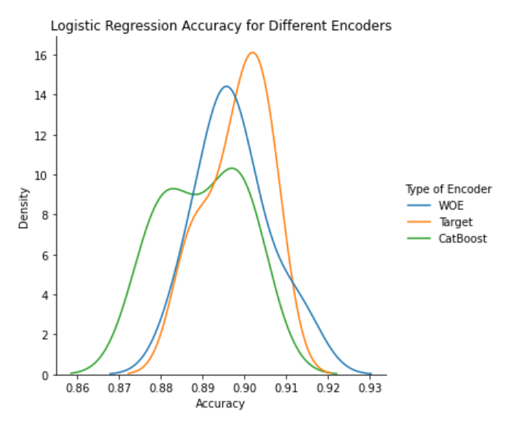
Training ML models – Logistic Regression with encoders
WOE and target encoder slightly improved model performance; target encoder is the optimal one up to now

Slide 12
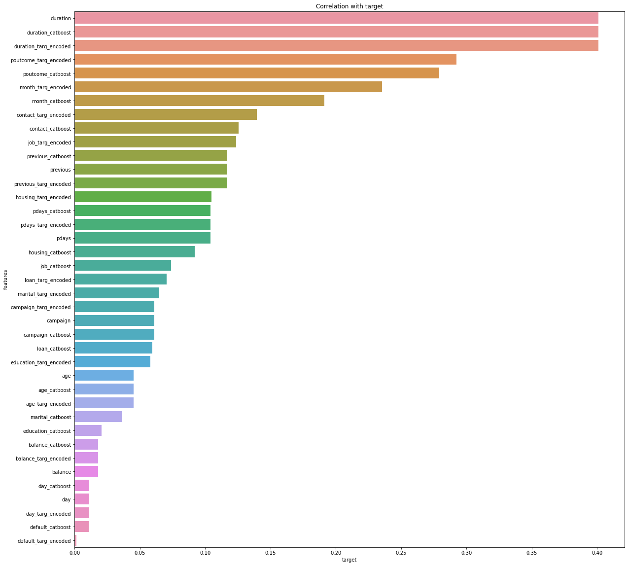
Training ML models – Logistic Regression with encoders
According to the correlation bar chart, encoding generally does not improve correlation score of features with target variable.

Slide 13
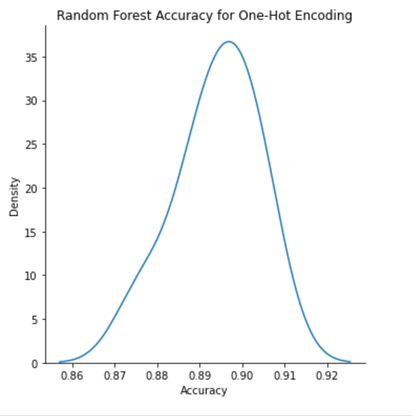
Training ML models – Random Forest
Random forest classifier has similar performance compared to logistic regression model.

Slide 14
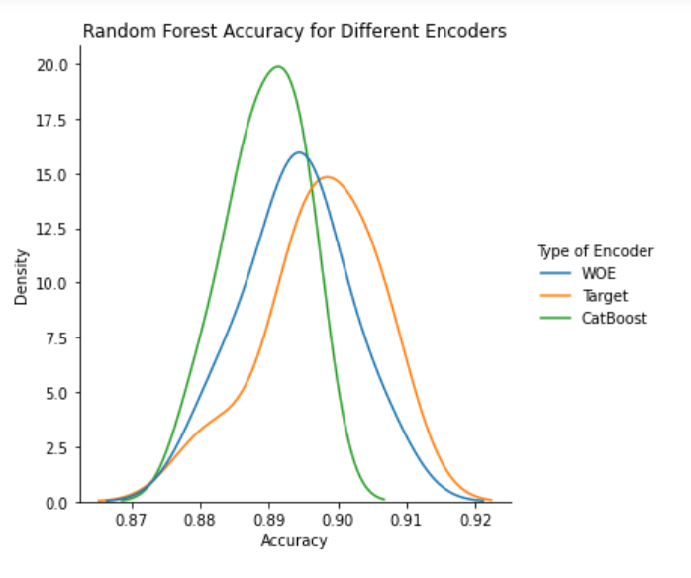
Training ML models – Random Forest with encoders
This time, again, three encoders performed the same, with target encoder being slightly better.

Slide 15
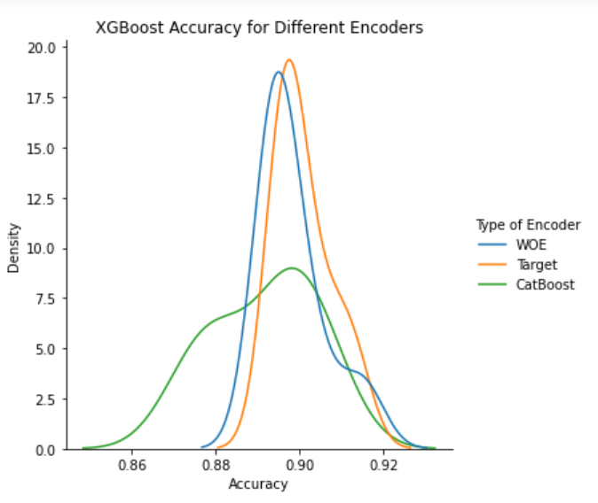
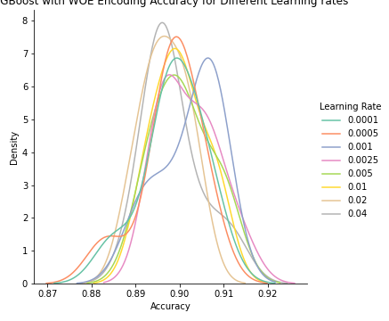
Training ML models – XGBoost
With XGBoost model, the prediction accuracy achieved 90.1%, exceeding 90% for the first time.
0.001 is the optimal learning rate.

Slide 16
Training ML models – Stacking
Metamodel | Prediction Accracy
Logistic | 89.96%
Decision Tree | 87.13%
Support Vector Machine | 89.63%
Random Forest | 89.21%
XGBoost | 88.99%
Surprisingly, stacking model did not perform as well as XGBoost, being a single component of it.

Slide 17
Model Selection
XGBoost model with target encoding achieved the highest prediction accuracy among all models, at a 90.2% level. Also it takes only 2.4 seconds to train.
Testing of the model on the entire dataset with duration feature dropped (because this feature may be hard to track in reality) yield a 89.3% accuracy, meaning the bank would make the best move on ~90% of its customers. Therefore, this model is highly recommended and applicable in industry use.

Slide 18
Thank You

